Slide 1
軟體工程設計 W6
許庭瑋、陳君翰、洪世彬、劉玠均、楊昕叡、林俊佑
2023/10/26

Slide 2
Code Tracing

Slide 3
Weekly Code Tracing Progress
 | Part | LOC
spring-core-core
許庭瑋 | PathMatchingResourcePatternResolver,ResourcePatternResolver | 585
楊昕叡 | TypeMappedAnnotation.java | 527
劉玠均 | 14 converters (scalar + enum), 6 converter factories, exceptions | 561
洪世彬 | org.springframework.core.env | 774
spring-core-aot, spring-core-cglib
陳君翰 | org.springframework.aot.hint | 476
林俊佑 | core/AbstractClassGenerator | 390

Slide 4
許庭瑋
PathMatchingResourcePatternResolver
Use to read class under specified classpath
Usage example:
Implementation of ResourcePatternResolver
can get resources by getResources()
provide some functions to find different kinds of resources, like findAllClassPathResources, findPathMatchingResources, doFindPathMatchingJarResources, doFindPathMatchingFileResources…
Notes:
ConvertingComparator<S, T>, DefaultConversionService, 8 default converters

Slide 5
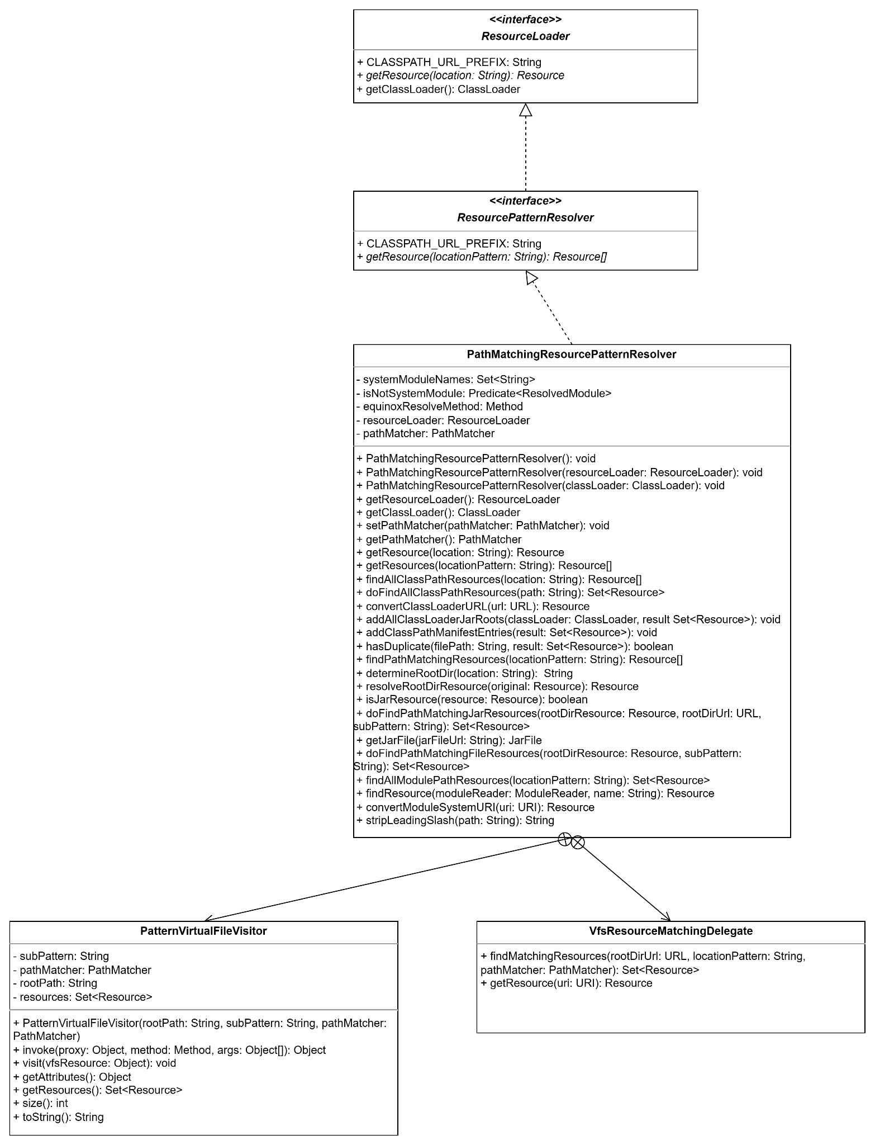
許庭瑋 (my full class diagram)
current class diagram about Resource loader
mainly PathMatchingResourcePatternResolver
2 above are interfeces, 2 below are inner classes
Notes:
ConvertingComparator<S, T>, DefaultConversionService, 8 default converters

Slide 6
楊昕叡
final class TypeMappedAnnotation<A extends Annotation> extends AbstractMergedAnnotation<A>
1. implement abstract operations form abstract class
2. create map:attribute name->attributes&values with adaptations
3. get attribute value inside an attribute with a designated type(default value or after changed)
4. adapt a value (attribute…) to a designated type and an attribute method (because it wants to “get attribute value inside an attribute”)
5. Create a new MergedAnnotation instance given annotation/annotation type
6. create TypeMappedAnnotation instance if possible, or throw exception
7. create synthesized annotation

Slide 7
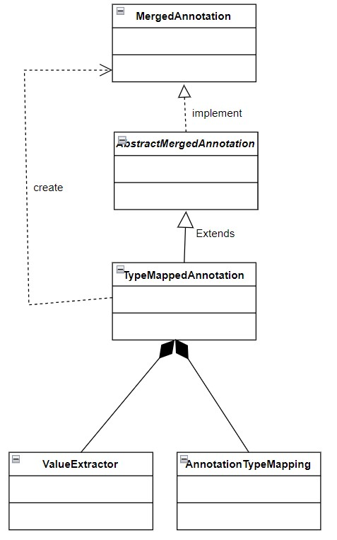
楊昕叡
class diagram: full version
some methods use polymorphism
Some methods’ return type is MergedAnnotation, but it in fact returns TypeMappedAnnotation, which extends AbstractMergedAnnotation, which implements MergedAnnotation.
Notes:
ConvertingComparator<S, T>, DefaultConversionService, 8 default converters

Slide 8
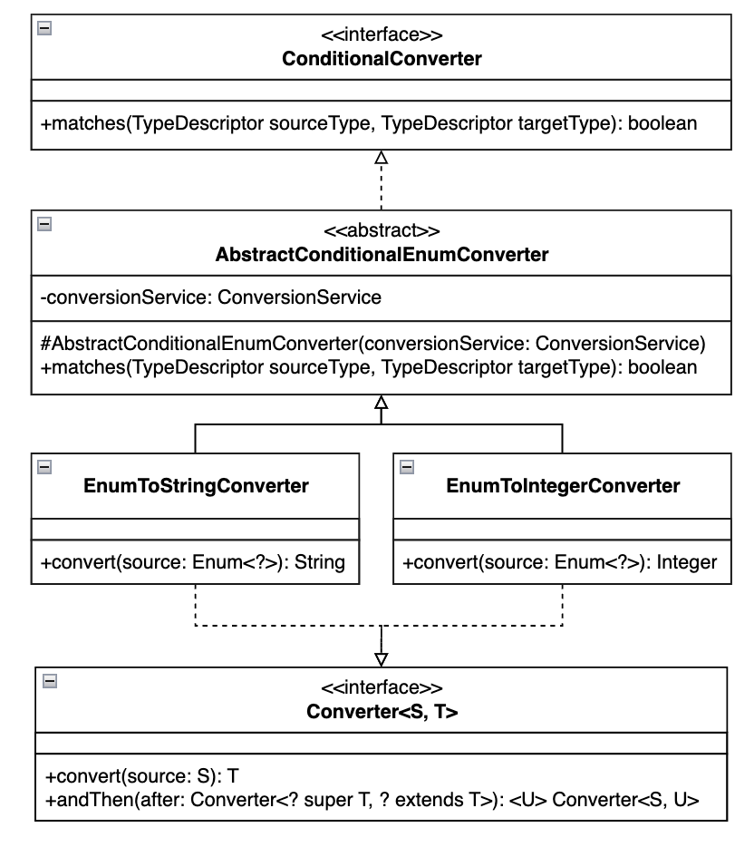
劉玠均
Converters (class diagram full version)
Default converters (W4)
Collection converters (W5)
Scalar converters, AbstractConditionalEnumConverter (W6)
Scalar converters
Coverters for converting String to other types: Boolean, Character, Charset, Concurrency, Locale, Pattern, Properties, Regex, UUID
AbstractConditionalEnumConverter
Conditional converters for converting matched types from Enum to String or Integer. For example, String and Date are matched types.
Notes:
ConvertingComparator<S, T>, DefaultConversionService, 8 default converters

Slide 9
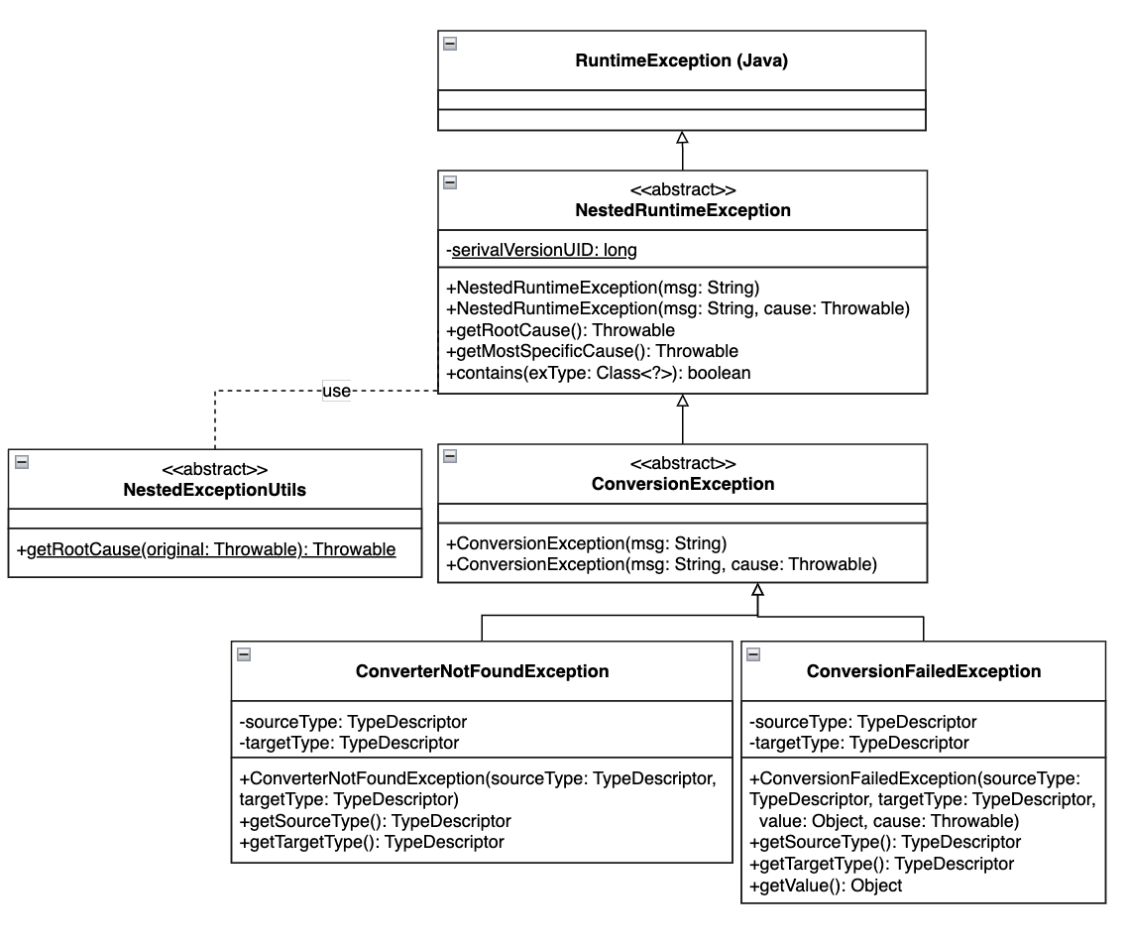
劉玠均
Factory (see full version)
Concrete factory for getting a specific converter.
A specific converter here is defined as a private static class (i.e., <T extends Converter>) inside the factory.
For example, NumberToNumberConverterFactory contains a static private class NumberToNumber converter.
Exception
Define ConverterNotFound and ConversionFailed exceptions.

Slide 10
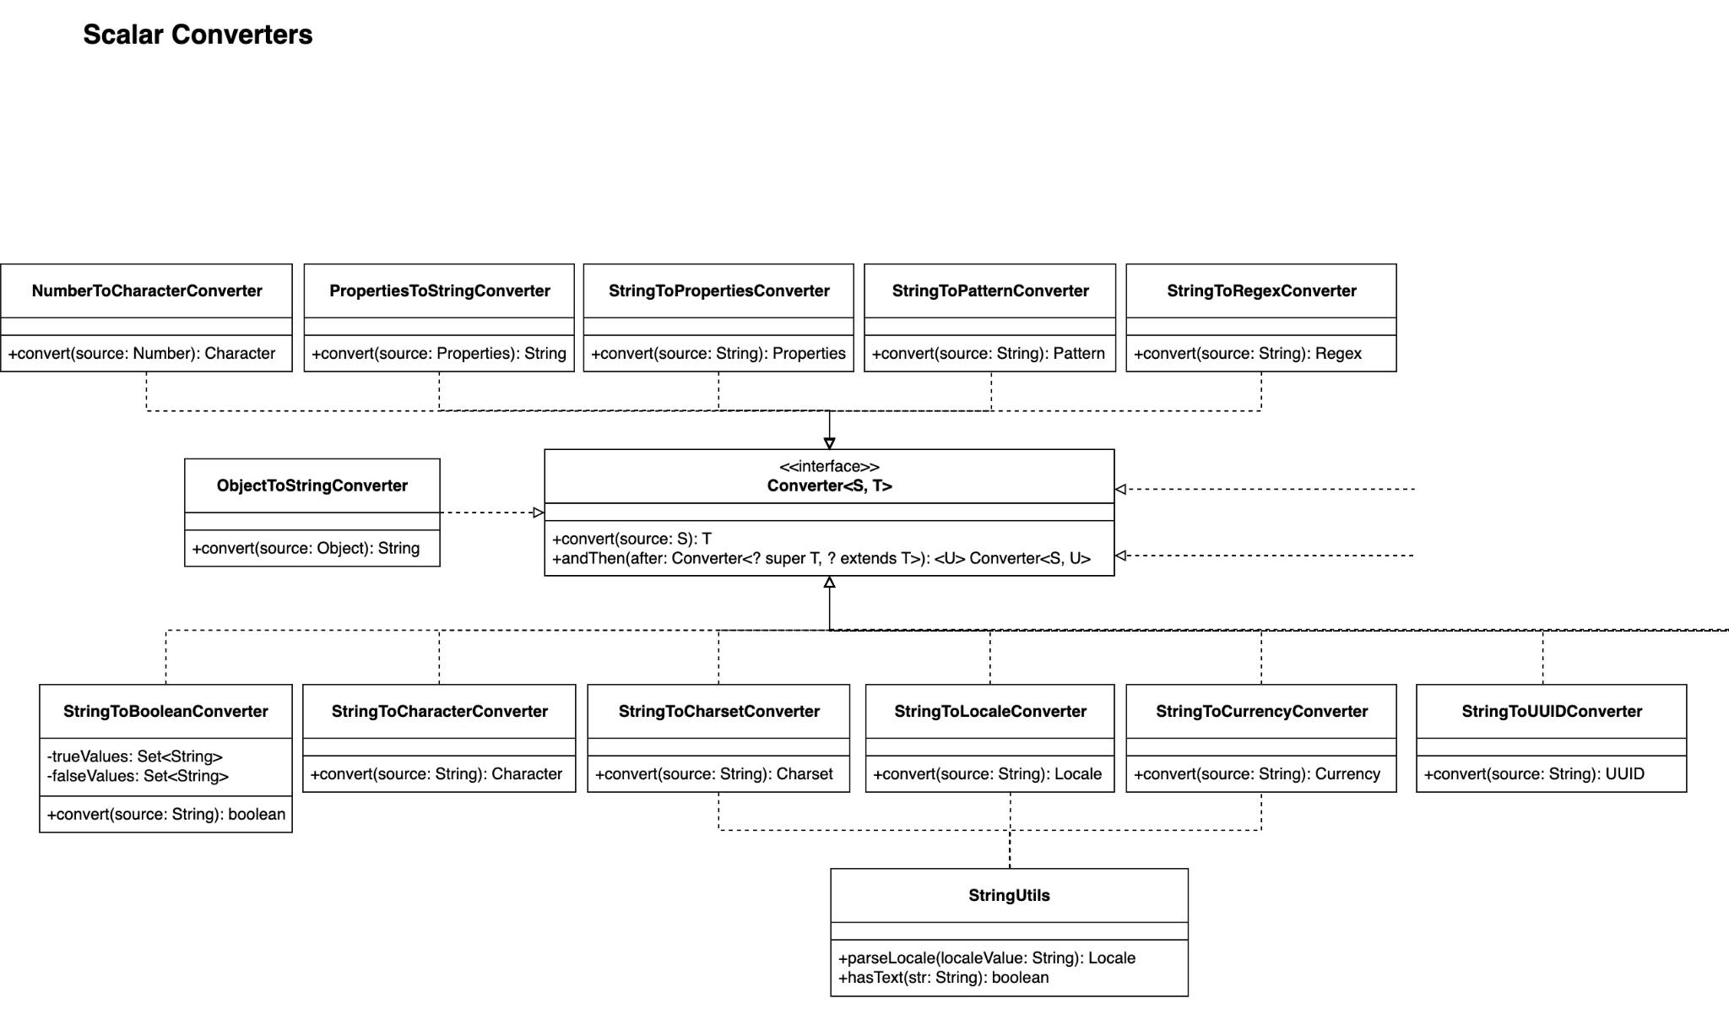

Slide 11
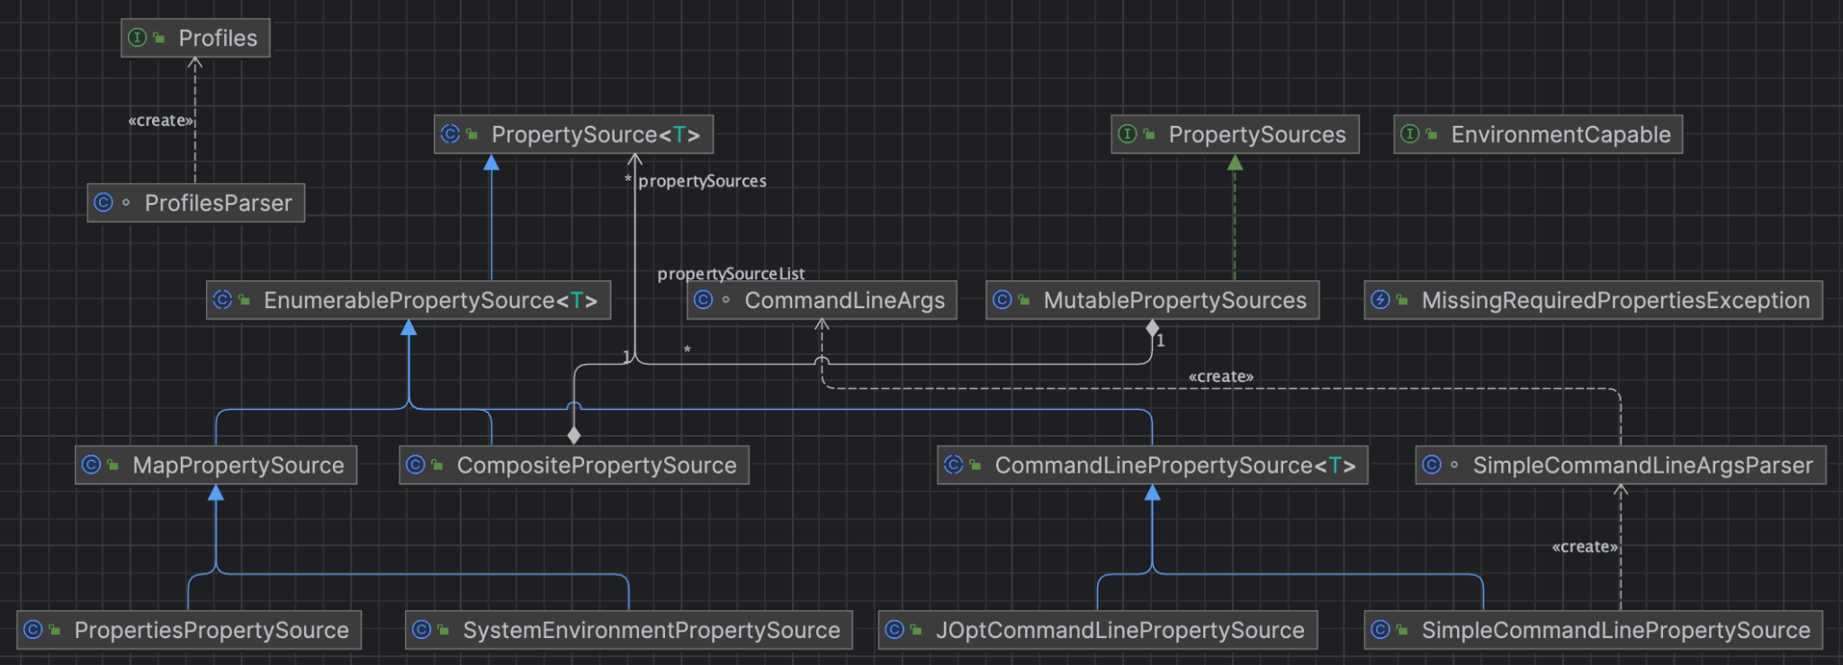
洪世彬
PropertySourcesPropertyResolver contains a collection of PropertySources, where each PropertySource represents an object for properties in the Environment.

Slide 12
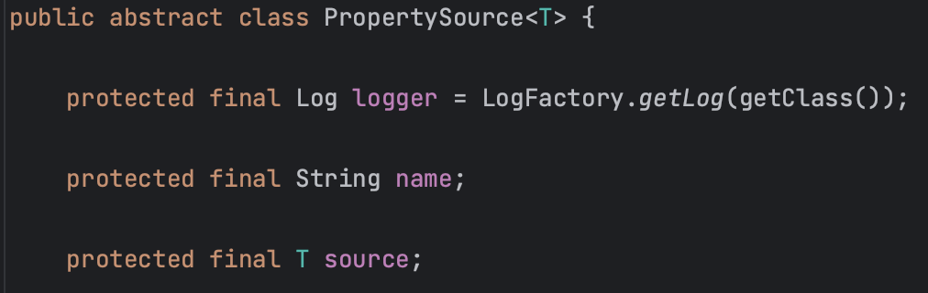
洪世彬
A PropertySource consists of a name and a generic type T object, with T usually implemented as Object in most cases.

Slide 13
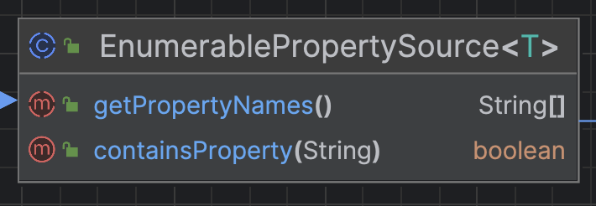
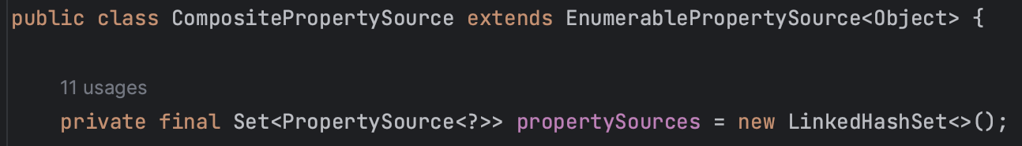
洪世彬
What makes it interesting is EnumerablePropertySource<T>, which extends PropertySource<T> and adds a method called getPropertyNames, allowing external access to multiple PropertySources at once. Its subclasses also provide different implementations for multiple storage types, such as Set or Map.

Slide 14
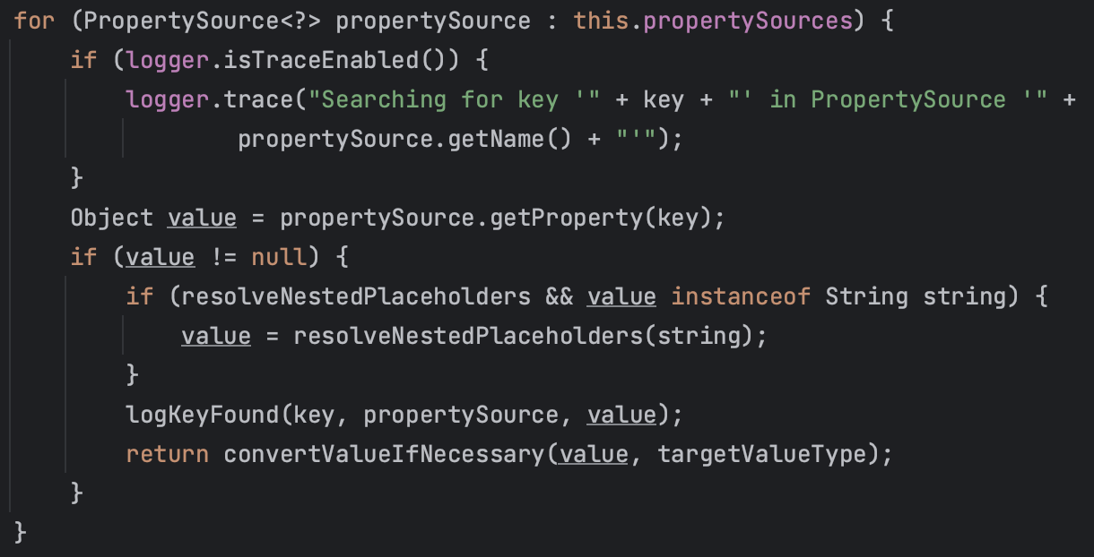
洪世彬
Another way to access these properties is through PropertySources, which inherits from Iterable<PropertySource<?>>. This allows PropertySources to be used in a for-each loop.

Slide 15
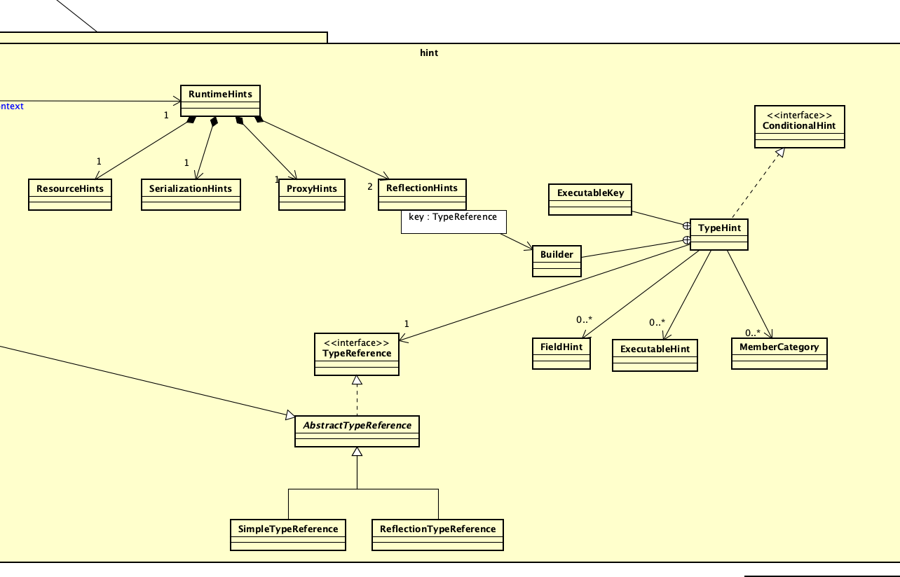
陳君翰

Slide 16
陳君翰
Runtime hint are provided to AOT compiler to optimize the application runtime. It requires the following hints, which can be dynamically created in JVM runtime, but not the AOT.
reflection: the need to access class by its name.
resources
serialization: the need to convert between objects and binary serials.
proxies
There are also conditional hints, which are contracts for runtime hints that only apply if the described condition is met.
There is also a special Builer Patter in TypeHint that needs to be discovered more.

Slide 17
林俊佑
class 生成的 cache 機制（有不用 cache 的機制, 這邊用 cache）
step:
外部介面要求創建代理 class (AbstractClassGenerator 的繼承)
使用 外部介面.create 調用 外部介面.createHelper
使用 外部介面.createHelper 調用 AbstractClassGenerator.create
AbstractClassGenerator.create 調用 AbstractClassGenerator.getClassLoader
查看 local 的 cache 有沒有對應的 ClassLoaderData
沒有時取該 class 的 classLoader 生成 ClassLoaderData, 生成後 map 存入生成函數, 順便執行函數且把結果的 class 存入 cache (生成函數配合 ReflectUtils, strategy 產生 Class)
從 cache 取出對應 class 回傳

